Slide 1
New in .net
Let’s grow 30 augustus 2022

Slide 2
major topics
Modern Client Development: .NET MAUI
Cloud and Native Containers
Upgrading existing .NET Apps
JWT Authentication improvements & Automatic Configuration
C# 11

Slide 3

Installing .net 7
Download .NET 7
https://dotnet.microsoft.com/en-us/download/dotnet/7.0
Use Visual Studio 2022
https://visualstudio.microsoft.com/vs/
Enable “use previews of the .NET SDK” under Tools, Options, Environment, Preview Features

Slide 4
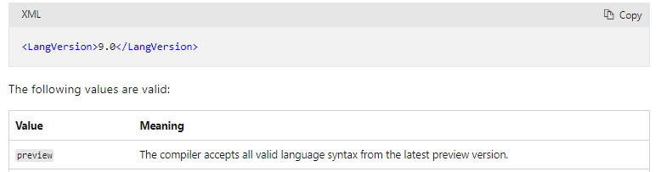
Installing .net 7
Set LangVersion to preview

Slide 5
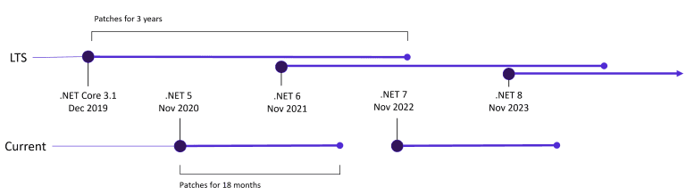
.NET Release cycle & support policy
Starting with .Net 5, Microsoft committed to a yearly release of a new .Net version. The release will usually be on November each year.
There’s a difference between Even .Net version numbers & Odd version numbers. .Net 6 & .Net 8 are long-term supported versions. These versions will get patches for 3 years. Whereas .Net 7 is a short term release that will get patches for 18 months, which means after the .Net 8 comes out, you will have around 6 months to upgrade from .Net 7 to .Net 8.

Slide 6
Modern client development: .net maui
.Net MAUI is the new cross-platform native UI development toolkit for the .Net & will be part of .Net 7. MAUI preview 13 has been released with improved tooling & performance.

Slide 7
Cloud Native & Containers
Microsoft wants to focus on the developers journey for cloud native applications. Specifically they want to improve 2 points with .Net 7:
Simplifying the setup & configuration necessary to implement secure authentication and authorization.
Improving the performance of application startup & runtime execution.
If we talk about improvements, Microsoft announced that they’ll continue to invest in Orleans, which is a .Net cross-platform framework for building distributed applications.
They also plan to simplify & improve the developer experience for containerized .Net applications.

Slide 8
JWT Authentication Improvements & Automatic Configuration
This is one of the Best Improvement Microsoft Announced in .Net 7 Preview 5 with some great improvements. I have written a detailed article on how we can configure JWT Authentication in .Net.
https://dottutorials.net/jwt-authentication-configuration-in-asp-net-7/
Notes:
https://dottutorials.net/jwt-authentication-configuration-in-asp-net-7/

Slide 9
Some more improvements & features
A lot is going on Asp.Net Core development. I mentioned 4 improvements above that I believe are the most important. There are some more to mention.
Performance Improvements
Additional performance improvements with .Net 7 to make it faster & more efficient. .Net 6 already had a massive impact on performance & .Net 7 will take this even further. Even if you don’t run into performance issues today, it will save your money without altering your source code when running on the cloud.
Official HTTP 3 Support
Http 3 was shipped as a preview feature in .Net 6 & will be a part of .Net 7 & enabled by default. In future .Net 7 preview versions, we’ll see performance improvements & additional tls features.

Slide 10
Some more improvements & features
Minimal APIs Improvements
Minimal APIs were introduced in .Net 6 & allows you to create lightweight APIs without the overhead of controllers.
With .Net 7, we will see additional improvements & support for currently missing features like grouping endpoints with a common route prefix. Endpoint filters will allow you to implement crosscutting concerns that you can only do with controllers using action filters today.
Blazor Hybrid Support
Blazor Hybrid Support will allow us to take existing Blazor components & put them together into a desktop application using a webview control with access to all underlying hardware APIs. It will allow developers to use web technologies to build desktop applications with access to system resources such as the local file system or a webcam.

Slide 11
C# 11
C# 11 is about to Release in November 2022 with some great features. Most of the features are focused on pure performance (up to 73.5% faster). There are many improvements that will change the way you code.
Notes:
https://dottutorials.net/whats-new-csharp-11-features/

Slide 12
Required Members
C# 11 introduces a new required modifier to fields & properties to impose constructors & callers to initialize those values.
A new SetsRequiredMembers attribute on the constructor tells the compiler that it initializes all required members.

Slide 13
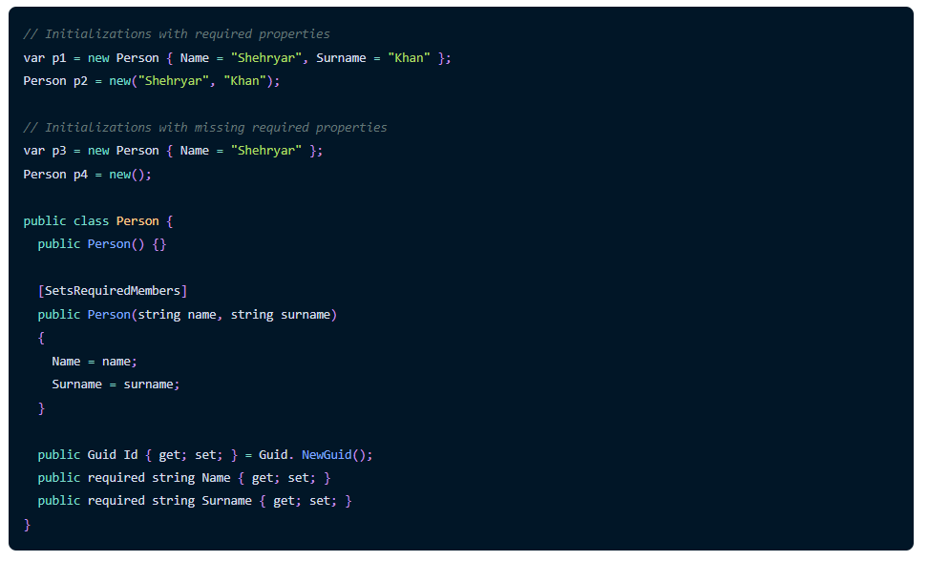

Slide 14
Raw string Literals
C# 11 preview introduces raw string literals.
It allows containing of arbitrary text without escaping.
The format is minimum 3 double quotes """.."""
Combining with string interpolation, the count of $ denotes how many braces in a row start & end the interpolation.

Slide 15
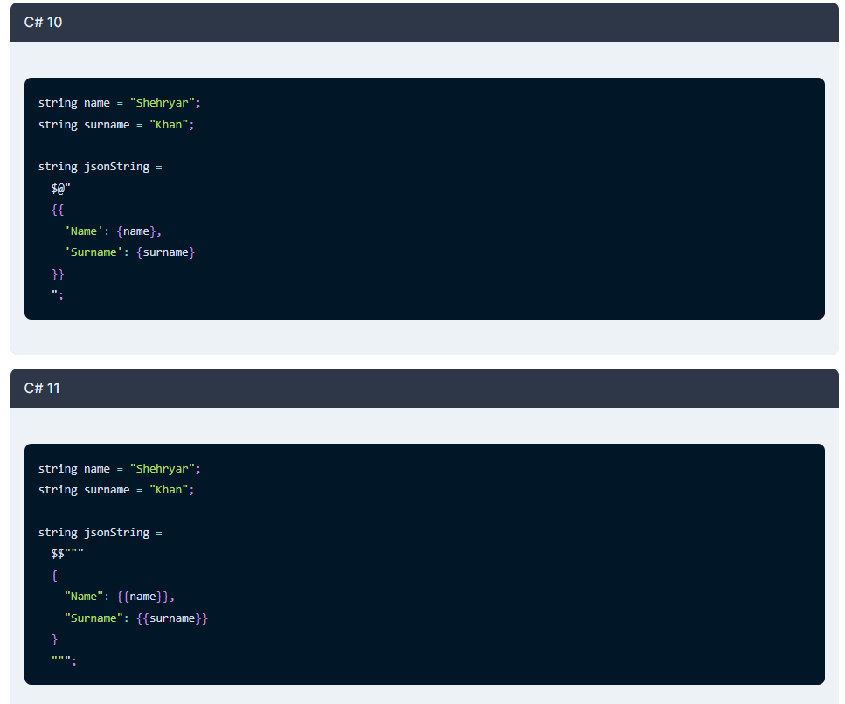

Slide 16
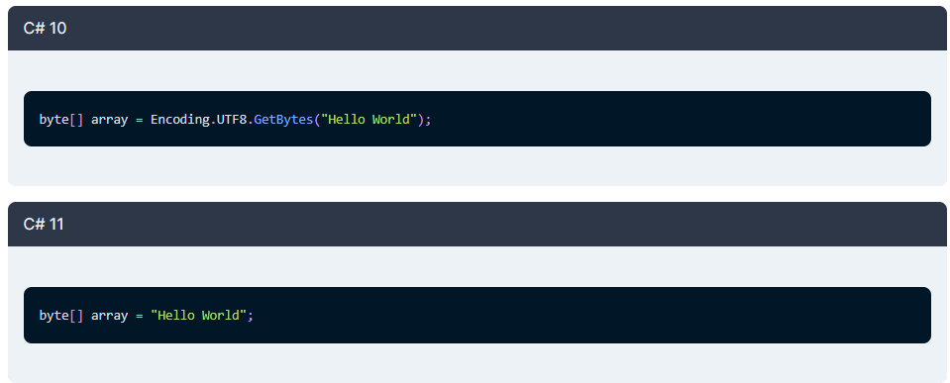
UTF-8 string literals
C# 11 preview introduces UTF-8 string literals.
It allows converting only UTF-8 characters to their byte representation at compile time.

Slide 17
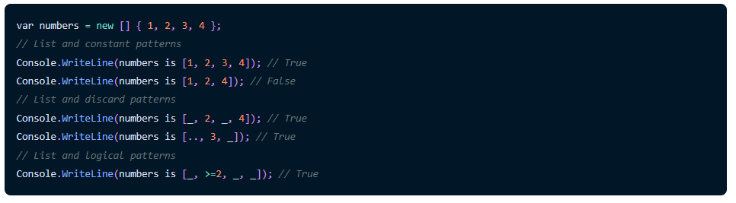
List Patterns
C# 11 preview introduces list patterns.
It expand pattern matching to match sequences of elements in a list or an array.
You can use list patterns with any pattern, including property, type, constant, & relational patterns.

Slide 18
Newlines in string interpolation expressions
C# 11 preview introduces newlines in string interpolation.
It allows any valid C# code between { }, including newlines, to improve code readability.
It also helpfuls when you want to use longer C# expressions in interpolation, e.g. LINQ queries, pattern matching or switch expressions.

Slide 19
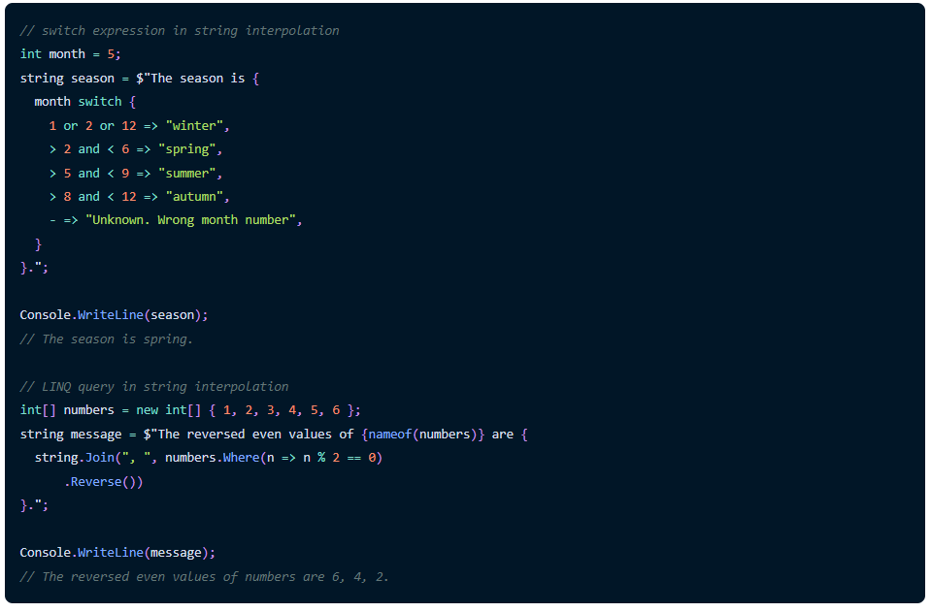

Slide 20
Auto-default structs
The C# 11 compiler itself initializes any property or field not initialized by a constructor in the structs.
Such code doesn’t compile in the previous C# versions.
The compiler sets the default values.

Slide 21
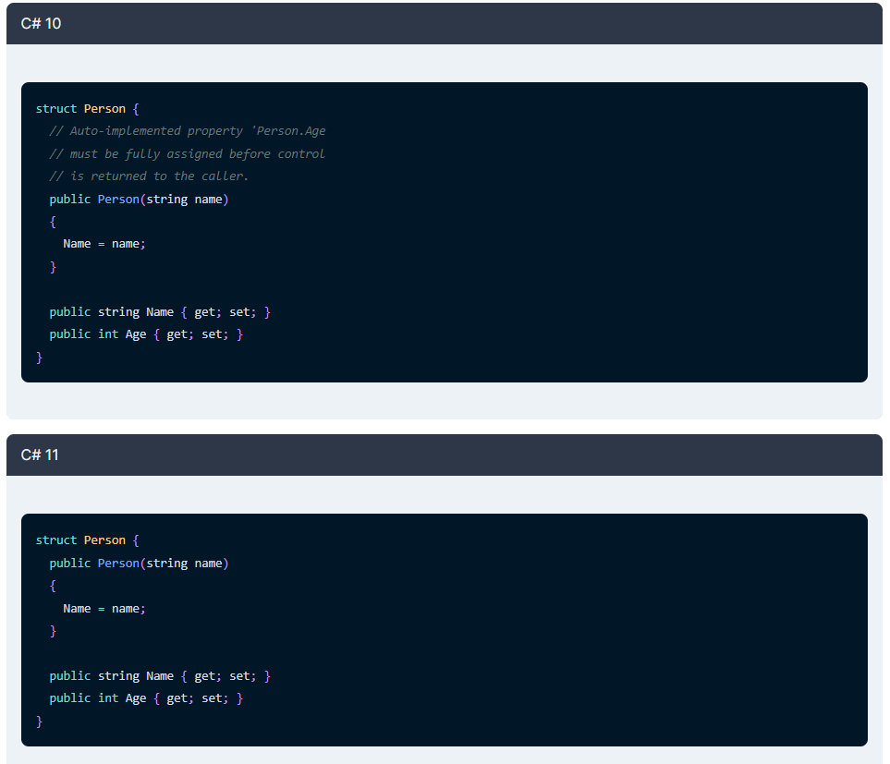

Slide 22
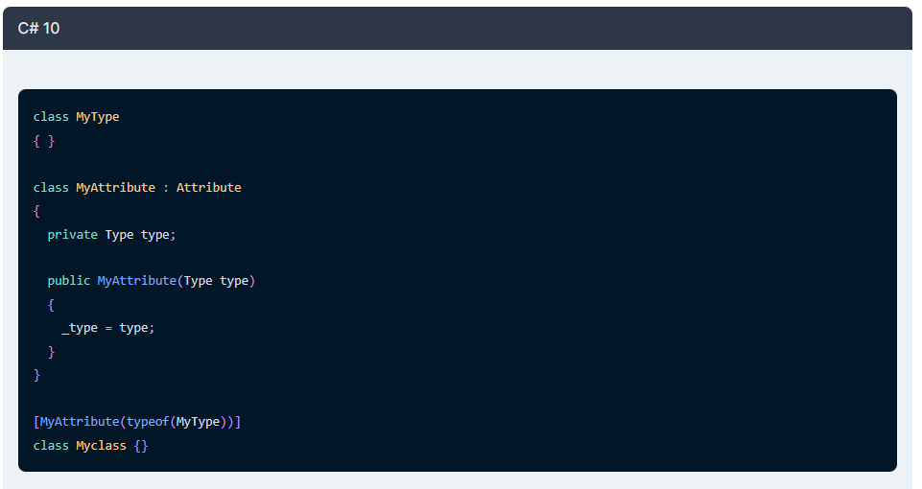
Generic attributes

Slide 23
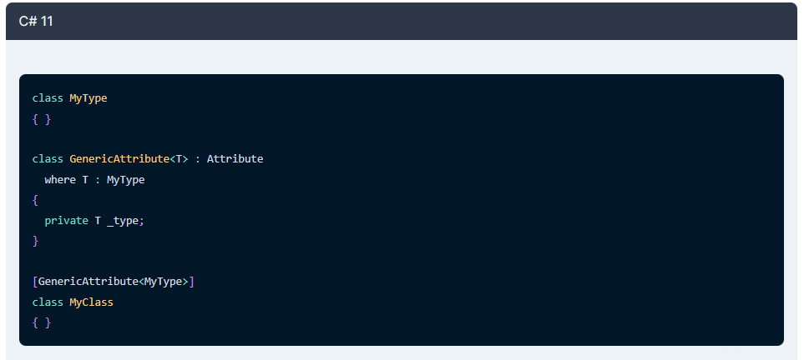

Slide 24
Extended nameof scope
C# 11 expand scope of nameof expressions.
We can specify the name of a method parameter in an attribute on the parameter declaration or method.
This can be used in adding attributes for code analysis.

Slide 25
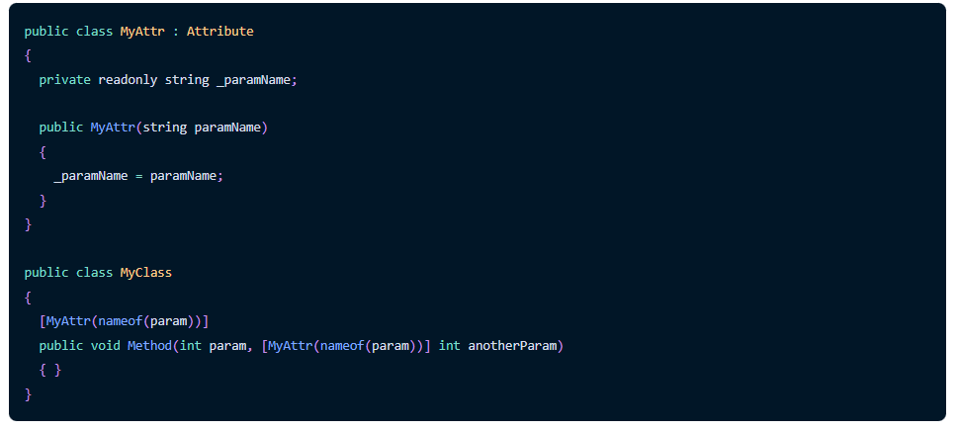

Slide 26
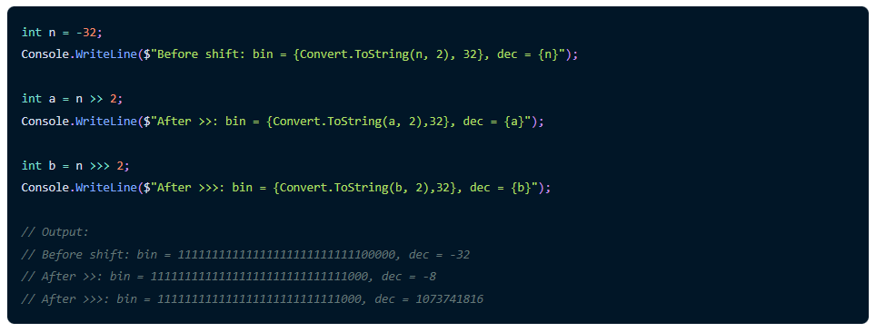
An unsigned right-shift operator
C# 11 introduces an unsigned right-shift operator >>>.
It shifts bits right without replicating the high order bit on each shift.

Slide 27
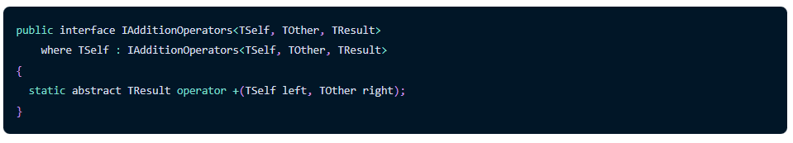
Static abstract members in interfaces for generic math support
C# 11 introduces static abstract members in interfaces.
We can add static abstract members in interfaces to define interfaces that include other static members, overloadable operators, and static properties.

Slide 28
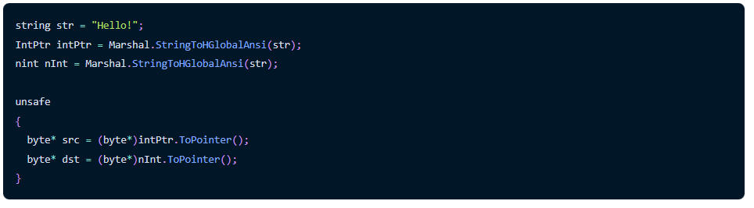
Numeric IntPtr
A little improvement in C# 11.
The nint and nuint types now alias System.IntPtr and System.UIntPtr respectively.

Slide 29
new Regex Source Generator
Have you ever wished you had all of the great benefits that come from having a specialized Regex engine that is optimized for your particular pattern, without the overhead of building this engine at runtime?
We are excited to announce the new Regex Source Generator which was included in Preview 1. It brings all of the performance benefits from our compiled engine without the startup cost, and it has additional benefits, like providing a great debugging experience as well as being trimming-friendly. If your pattern is known at compile-time, then the new regex source generator is the way to go.
In order to start using it, you only need to turn the containing type into a partial one, and declare a new partial method with the RegexGenerator attribute that will return the optimized Regex object, and that’s it! The source generator will fill the implementation of that method for you, and will get updated automatically as you make changes to your pattern or to the additional options that you pass in. Here is an example:
Notes:
https://devblogs.microsoft.com/dotnet/announcing-dotnet-7-preview-2/

Slide 30
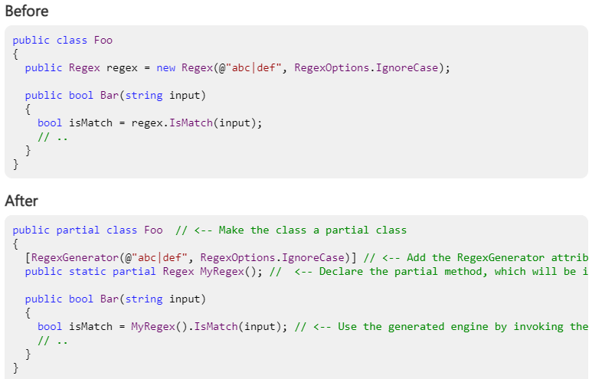

Slide 31
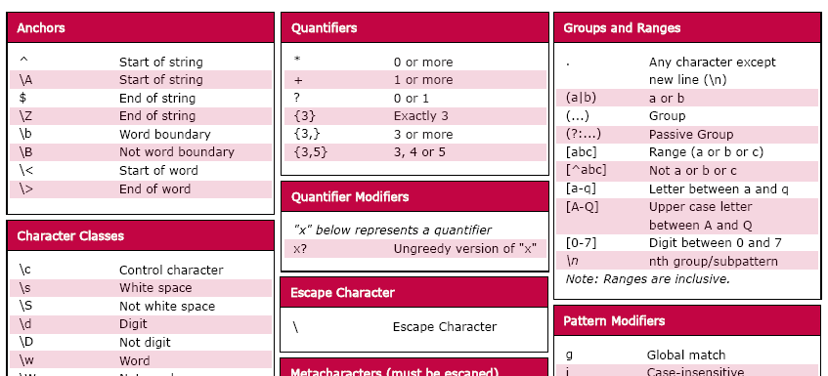
Regular expressions
http://lh5.ggpht.com/_gtwPxD0RCuM/S03_2SoW8iI/AAAAAAAAAs8/g_E8nD9B-eQ/s1600-h/regularexpressions%5B7%5D.png

Slide 32
Faster, Lighter Apps with Native AOT
In the .NET 7 Preview 2 blog post, we announced that the Native AOT project has been moved out of experimental status and into mainline development in .NET 7 in the dotnet/runtime repo. We know that many of you have been eagerly awaiting updates from the team on what’s coming for Native AOT, and we have a couple of new updates for you for Preview 3.
If you want details about Native AOT, or to jump in and get started with it, the repo docs are the best place for that.
We also recognize that some of you might not be familiar with what Native AOT is, so we wanted to share a quick overview of it with you.

Slide 33
What is Native AOT?
Ahead-of-time (AOT) compilation refers to an umbrella of technologies which generate code at application build time, instead of run-time. AOT is not new to .NET. Today we ship ReadyToRun for client and server scenarios, and Mono AOT for mobile and WASM. Native AOT brings full native pre-compilation to .NET desktop client and server scenarios. Native AOT is not replacing these existing technologies, rather it’s offering a new set of capabilities that unlocks new form factors.
Existing AOT-compiled .NET assemblies contain platform-specific data structures and native code to frontload work typically done at runtime. Precompiling these artifacts saves time at startup (e.g. ReadyToRun), and enables access to no-JIT platforms (e.g. iOS). If precompiled artifacts are not present, .NET either falls back to JIT or interpretation (depending on the platform).
Native AOT is similar to .NET’s existing AOT technologies, but it produces only native artifacts. In fact, the Native AOT runtime does not know how to read the .NET assembly file formats – everything is platform-native. The executable file format parsing is fully handled by the underlying operating system.

Slide 34
What is Native AOT?
The main advantage of Native AOT is in startup time, memory usage, accessing to restricted platforms (no JIT allowed), and smaller size on disk. Applications start running the moment the operating system pages in them into memory. The data structures are optimized for running AOT generated code, not for compiling new code at runtime. This is similar to how languages like Go, Swift, and Rust compile. Native AOT is best suited for environments where startup time matters the most. Targeting Native AOT has stricter requirements than general .NET Core/5+ applications and libraries. Native AOT forbids emitting new code at runtime (e.g. Reflection.Emit), and loading new .NET assemblies at runtime (eg. plug-in models).

Slide 35
Prepare your apps for Native AOT
For .NET 7 we are targeting console apps and native libraries as the primary scenario for Native AOT. Application developers and library authors can now take advantage of Native AOT by ensuring that their applications are trimmable. Since trimming is a requirement for Native AOT compilation, preparing your applications and libraries now for trimming will help them get ready for Native AOT as well. If you are an author of any .NET libraries, following the “Trimming libraries” instructions specifically will help you prepare your libraries for trimming and Native AOT.
One of the apps that we’re planning to ship in .NET 7 compiled with Native AOT is the crossgen tool. Crossgen is part of the .NET SDK. It’s the CoreCLR AOT compiler that produces ReadyToRun executables. Crossgen is written in C# and we currently ship it compiled with itself as a ReadyToRun app (it’s turtles all the way down!). We’re already seeing some very promising numbers in terms of compilation speed and size. Crossgen benefits heavily from Native AOT because it’s a short-lived process and the startup overhead dominates the overall execution time:

Slide 36
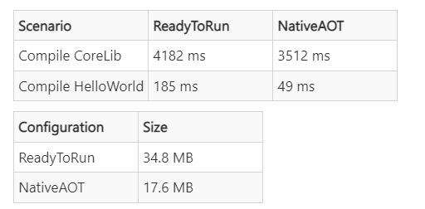
Prepare your apps for Native AOT
Looking ahead, Native AOT compatibility will be improved over the next few versions of .NET, however there will always be reasons to prefer JIT for many scenarios. We will also add first-class support in the dotnet SDK for publishing projects with Native AOT.

Slide 37
Adding Microseconds and Nanoseconds to TimeStamp, DateTime, DateTimeOffset, and TimeOnly
Prior to Preview 4, the lowest increment of time available in the various date and time structures was the “tick” available in the Ticks property. In .NET, a single tick is 100ns. Developers traditionally have had to perform computations on the “tick” value to determine microsecond and nanosecond values. Preview 4 addresses that by introducing both microseconds and milliseconds to the date and time implementations. Here is the new API surface area:

Slide 38
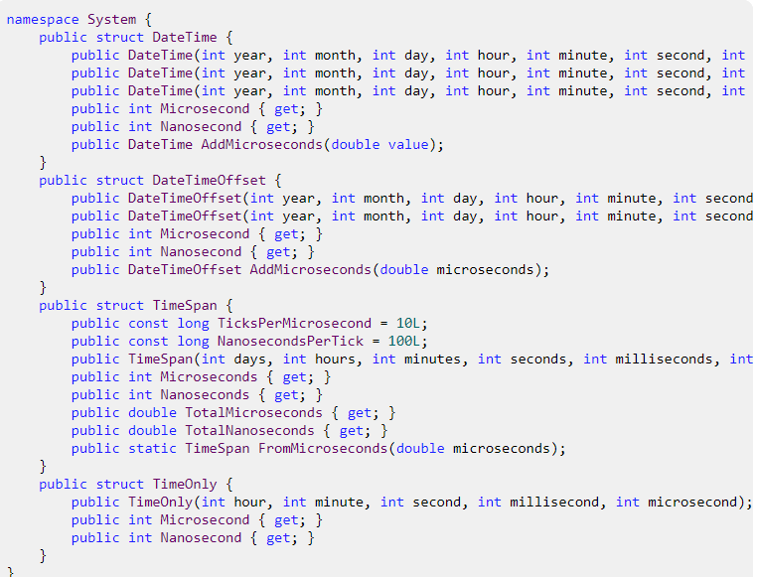
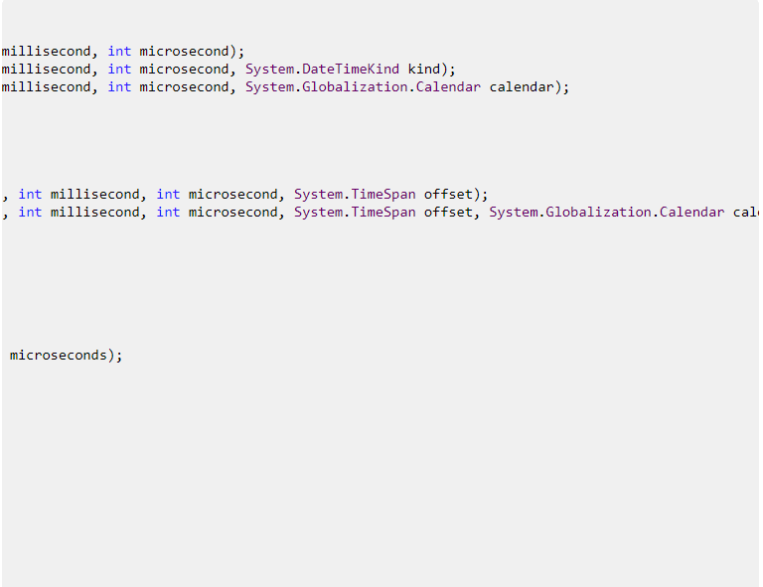

Slide 39
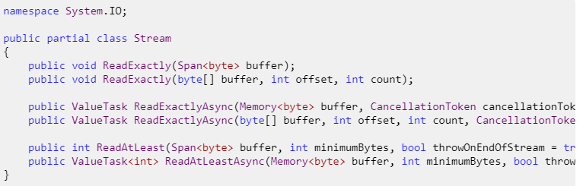
System.IO.Stream ReadExactly and ReadAtLeast
One of the most common mistakes when using Stream.Read() is that Read() may return less data than what is available in the Stream and less data than the buffer being passed in. And even for programmers who are aware of this, having to write the same loop every single time they want to read from a Stream is annoying.
To help this situation, we have added new methods to the base System.IO.Stream class:

Slide 40

ReadExactly
he new ReadExactly methods are guaranteed to read exactly the number of bytes requested. If the Stream ends before the requested bytes have been read, an EndOfStreamException is thrown.

Slide 41
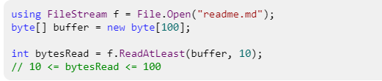
ReadAtLeast
The new ReadAtLeast methods will read at least the number of bytes requested. It can read more if more data is readily available, up to the size of the buffer. If the Stream ends before the requested bytes have been read an EndOfStreamException is thrown (in advanced cases when you want the benefits of ReadAtLeast but you also want to handle the end-of-stream scenario yourself, you can opt out of throwing the exception).

Slide 42
JSON contract customization
In certain situations developers serializing or deserializing JSON find that they don’t want to or cannot change types because they either come from external library or it would greatly pollute the code but need to make some changes which influence serialization like removing property, changing how numbers get serialized, how object is created etc. They frequently are forced to either write wrappers or custom converters which are not only a hassle but also make serialization slower.
JSON contract customization allows user for more control over what and how types get serialized or deserialized.
Notes:
https://devblogs.microsoft.com/dotnet/announcing-dotnet-7-preview-6/

Slide 43
Opting into customization
There are two basic ways developers can “plug” into the customization, they both end up assigning JsonSerializerOptions.TypeInfoResolver and require assigning resolver:
Developer can use DefaultJsonTypeInfoResolver and add their modifier, all modifiers will be called serially:
Writing own custom resolver by implementing System.Text.Json.Serialization.Metadata.IJsonTypeInfoResolver.
When type is not handled code should return null.
IJsonTypeInfoResolver can be combined with others into effective resolver which will return first non-null answer. For example JsonTypeInfoResolver.Combine(new MyResolver(), new DefaultJsonTypeInfoResolver()).

Slide 44
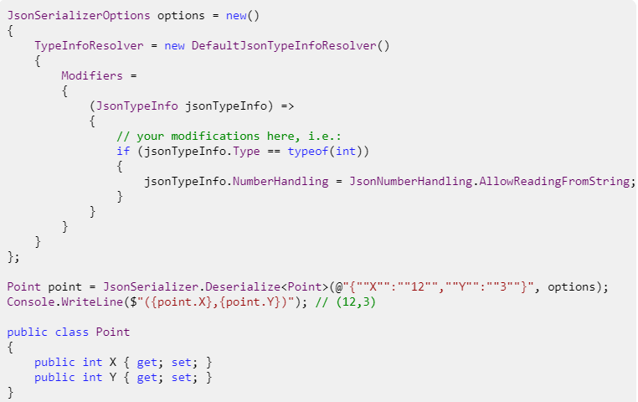

Slide 45
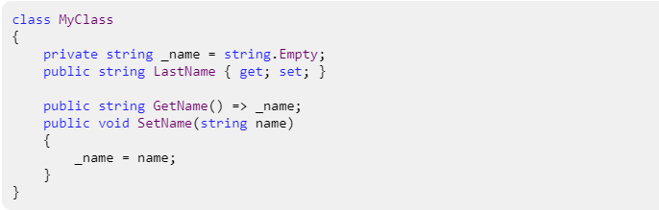
Customizing properties
Properties are only relevant when JsonTypeInfo.Kind == JsonTypeInfoKind.Object and in case of DefaultJsonTypeInfoResolver will be pre-populated. They can be modified or created by using JsonTypeInfo.CreateJsonPropertyInfo and added to the list of properties, i.e. say you got a class from separate library which has weirdly designed APIs which you can’t change:
Before this feature existed you’d need to wrap your type hierarchy or create your own custom converter for that type. Now you can simply fix it:

Slide 46
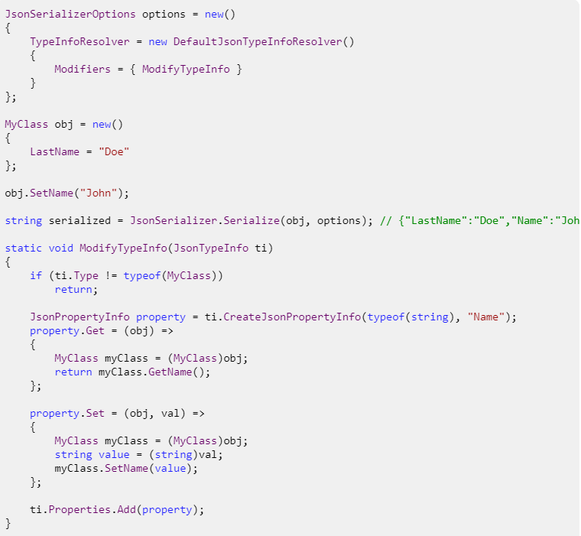

Slide 47
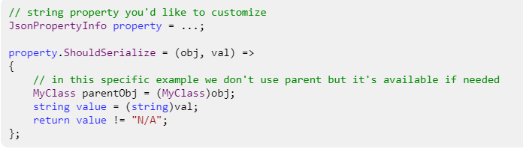
Conditional serialization of properties
In some usage scenarios it’s required that some default values don’t get serialized. I.e. you don’t want 0 to show up in JSON for certain properties. It was possible to get that scenario to work before by using JsonIgnoreAttribute with JsonIgnoreCondition.WhenWritingDefault. The problem occurs when your default value is not 0 and it’s something different, i.e. -1 or it depends on some external setting.
Now it’s possible to set your own predicate ShouldSerialize with any condition you’d like. I.e. say you have string property and you’d want N/A to not show up in JSON:

Slide 48
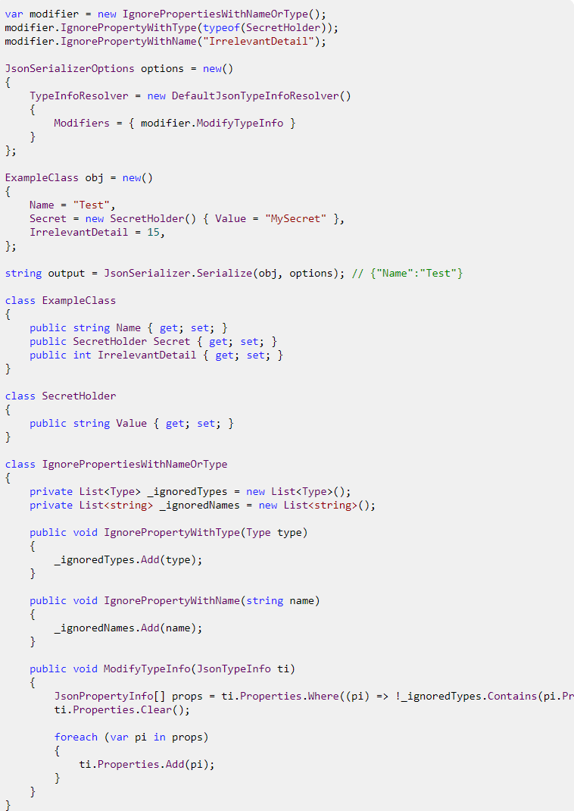

Slide 49

Simplified ordering with System.LINQ
System.Linq now has the methods Order and OrderDescending, which are there to order an IEnumerable according to T.
IQueryable also supports this now.

Slide 50


Usage
Previously, you had to call OrderBy/OrderByDescending by referencing the own value.
Now, you can write:

Slide 51
Entity Framework Core
Entity Framework (EF) Core is a lightweight, extensible, open source and cross-platform version of the popular Entity Framework data access technology.
EF Core can serve as an object-relational mapper (O/RM), which:
Enables .NET developers to work with a database using .NET objects.
Eliminates the need for most of the data-access code that typically needs to be written.

Slide 52
The model
With EF Core, data access is performed using a model. A model is made up of entity classes and a context object that represents a session with the database. The context object allows querying and saving data. For more information, see Creating a Model.
EF supports the following model development approaches:
Generate a model from an existing database.
Hand code a model to match the database.
Once a model is created, use EF Migrations to create a database from the model. Migrations allow evolving the database as the model changes.

Slide 53
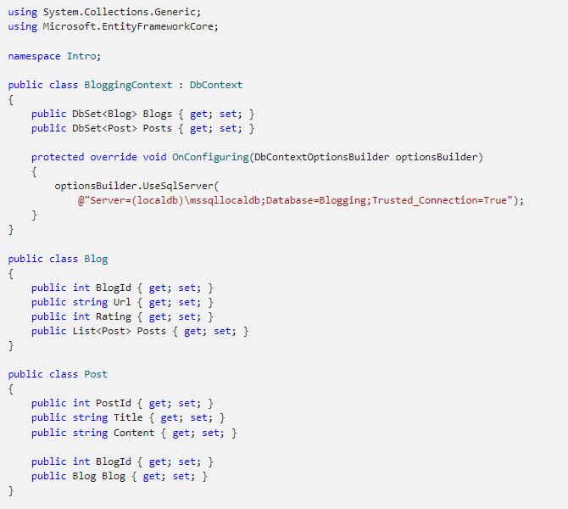

Slide 54
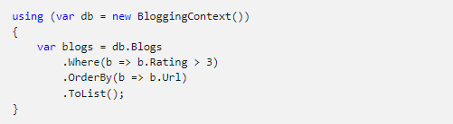
Querying
Instances of your entity classes are retrieved from the database using Language Integrated Query (LINQ).

Slide 55
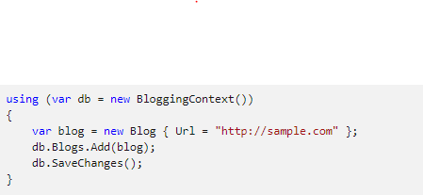
Saving data
Data is created, deleted, and modified in the database using instances of your entity classes.

Slide 56
EF O/RM considerations
While EF Core is good at abstracting many programming details, there are some best practices applicable to any O/RM that help to avoid common pitfalls in production apps:
Intermediate-level knowledge or higher of the underlying database server is essential to architect, debug, profile, and migrate data in high performance production apps. For example, knowledge of primary and foreign keys, constraints, indexes, normalization, DML and DDL statements, data types, profiling, etc.
Functional and integration testing: It's important to replicate the production environment as closely as possible to:
Find issues in the app that only show up when using a specific versions or edition of the database server.
Catch breaking changes when upgrading EF Core and other dependencies. For example, adding or upgrading frameworks like ASP.NET Core, OData, or AutoMapper. These dependencies can affect EF Core in unexpected ways.
Performance and stress testing with representative loads. The naïve usage of some features doesn't scale well. For example, multiple collections Includes, heavy use of lazy loading, conditional queries on non-indexed columns, massive updates and inserts with store-generated values, lack of concurrency handling, large models, inadequate cache policy.

Slide 57
EF O/RM considerations
Security review: For example, handling of connection strings and other secrets, database permissions for non-deployment operation, input validation for raw SQL, encryption for sensitive data.
Make sure logging and diagnostics are sufficient and usable. For example, appropriate logging configuration, query tags, and Application Insights.
Error recovery. Prepare contingencies for common failure scenarios such as version rollback, fallback servers, scale-out and load balancing, DoS mitigation, and data backups.
Application deployment and migration. Plan out how migrations are going to be applied during deployment; doing it at application start can suffer from concurrency issues and requires higher permissions than necessary for normal operation. Use staging to facilitate recovery from fatal errors during migration. For more information, see Applying Migrations.
Detailed examination and testing of generated migrations. Migrations should be thoroughly tested before being applied to production data. The shape of the schema and the column types cannot be easily changed once the tables contain production data. For example, on SQL Server, nvarchar(max) and decimal(18, 2) are rarely the best types for columns mapped to string and decimal properties, but those are the defaults that EF uses because it doesn't have knowledge of your specific scenario.

Slide 58
Getting Started with EF Core
In this tutorial, you create a .NET Core console app that performs data access against a SQLite database using Entity Framework Core.
You can follow the tutorial by using Visual Studio on Windows, or by using the .NET Core CLI on Windows, macOS, or Linux.
https://docs.microsoft.com/en-us/ef/core/get-started/overview/first-app?tabs=visual-studio

Slide 59
Razor Pages with Entity Framework Core in ASP.NET Core - Tutorial 1 of 8
This is the first in a series of tutorials that show how to use Entity Framework (EF) Core in an ASP.NET Core Razor Pages app. The tutorials build a web site for a fictional Contoso University. The site includes functionality such as student admission, course creation, and instructor assignments. The tutorial uses the code first approach.
https://docs.microsoft.com/en-us/aspnet/core/data/ef-rp/intro?view=aspnetcore-6.0&tabs=visual-studio
Notes:
https://docs.microsoft.com/en-us/aspnet/core/data/ef-rp/intro?view=aspnetcore-6.0&tabs=visual-studio

Slide 60
https://docs.microsoft.com/en-us/ef/core/what-is-new/ef-core-7.0/plan

